Slide 1

NATIONAL ENGINEERING COLLEGE, K.R.NAGAR, KOVILPATTI - 628 503
23CS24C -OBJECT ORIENTED PROGRAMMING USING C++ EXPERIENTIAL LEARNING LAB
TOUR MANAGEMENT SYSTEM
SUBMITTED BY:
Maha Manisha M (2312025)
TEAM MEMBERS:
Anusuyadevi N (2312005)
Dharshini K (2312012)

Slide 2
Problem Statement
• To create a tour management application using C++ that have features to book tour, update tour or cancel tour.
• To save the tour details of both customer and reservation details in a Separate files.
• To create an error free application that is capable to handle real life scenario.

Slide 3
Objective
1.Easy Booking Process: Simplify the process of creating, updating, and canceling tour booking s to ensure accuracy and user-friendliness
2.Customer Information Management: Maintain detailed and organized records of customers, including their personal information and booking history.
3.Secure Data Handling: Implement robust file handling with encryption to securely store and retrieve tour, customer, and booking information.
4.Comprehensive Tour Management: Allow for the addition, updating, and removal of tour packages with all necessary details.
5.User-Friendly Interface: Develop an intuitive user interface for easy navigation and interaction with the system.

Slide 4
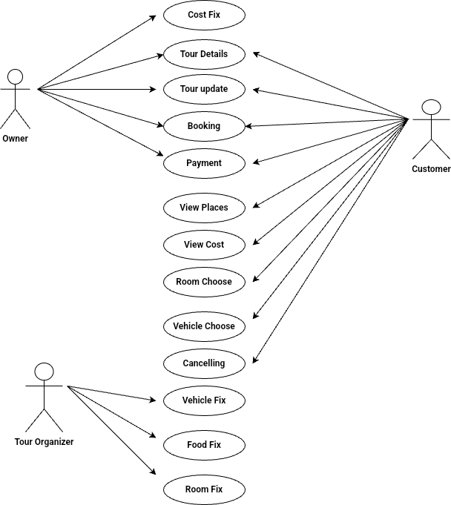
Usecase Diagram

Slide 5
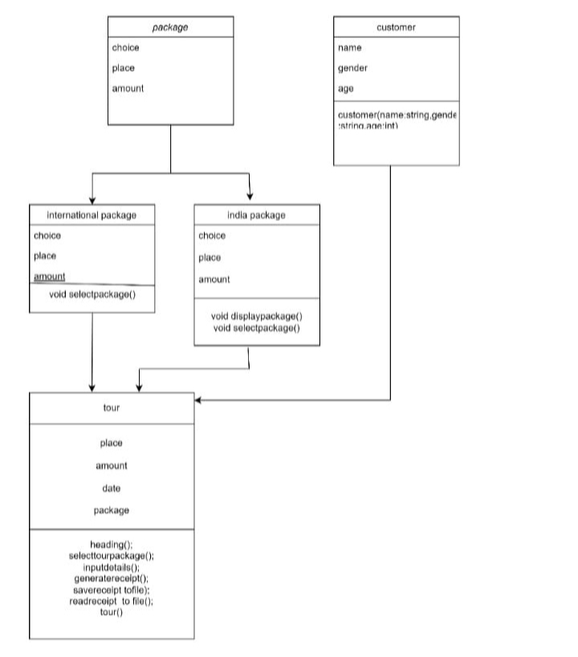
Class Diagram

Slide 6
Object Oriented Concept Ideation
1.Classes Used:
2.Inheritance:
The InternationalPackage and IndiaPackage classes inherit from the Package class using the public keyword.
This allows them to use the interface defined by Package while providing their own implementations of the virtual functions.
Customer-Base Class
InternationalPackage-Derived class
IndianPackage-Derived Class
Tour-Another class created to get the details from the passanger
3.Polymorphism:
The Package class defines two pure virtual functions (displayPackages() and selectPackage()) making it an abstract class.
The InternationalPackage and IndiaPackage classes override these virtual functions, allowing for dynamic binding. This is demonstrated by the use of a pointer to the base class Package* package which points to objects of derived classes (new InternationalPackage() or new IndiaPackage()).

Slide 7
4.Constructors and Destructors:
The Customer class has a parameterized constructor to initialize the data members.
The Tour class has a destructor that deletes the dynamically allocated package object to prevent memory leaks (~Tour() { delete package; })
5.Abstraction:
The Package class abstracts the concept of a package with virtual functions, hiding the specific details of each type of package.
The user interacts with the Tour class, which abstracts the process of selecting a tour package, inputting customer details, and generating a receipt.
5.Encapsulation:
Data members like name, gender, age, type, place, amount, departuredate, package, and customers are encapsulated within their respective classes.
Functions like inputDetails(), selectTourPackage(), generateReceipt(), saveReceiptToFile(), and readReceiptFromFile() provide controlled access to these data members.
6.File :
Used in saveReceiptToFile and readReceiptFromFile to handle persistent storage of tour receipts.

Slide 8
7.Templates:
Dynamic Storage of Customer Objects:
Flexibility: The vector dynamically grows as new Customer objects are added, eliminating the need to know the number of customers beforehand.
Ease of Use: Methods like push_back allow for easy addition of new customers, and size helps in determining the number of customers stored.
Efficient Management and Retrieval:
Memory Management: vector automatically handles memory allocation and deallocation, reducing the risk of memory errors.
Iteration: Provides convenient iteration over customer data using loops, making it straightforward to process and print customer details.

Slide 9
Implementation
https://docs.google.com/document/d/1djFX6doUdUk3ZENs9kgFIlPQ6EXx0A0-eRiCgb_N95U/edit?usp=drive_link

Slide 10
Demo
https://drive.google.com/file/d/11XYROW2NyYQMqZbgQyYQe8g30PXzuI4S/view?usp=drive_link

Slide 11

Thank You

